Slide 1
Twitter Sentiment Analysis: Executive Summary
Eric Vela

Slide 2
Variables Used
airline_sentiment – shows negative, neutral, or positive depending on the user’s flight experience.
negativereason – the reason why the flight experience was not very good
airline – self-explanatory in this context
name – the username of the person who tweeted about the airline
text – the tweet/message posted on to the site
user_timezone* - the relative location the tweet originated from (not the most useful measurement, not actually a time zone sometimes)

Slide 3
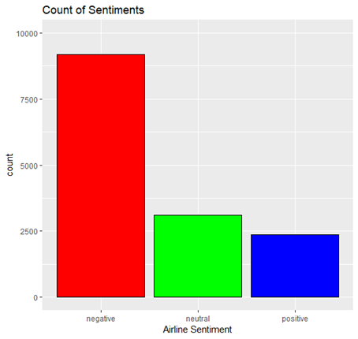
Sentiment Frequency
Negative sentiment count is 9178 (62.69%)
Neutral sentiment is 3099 (21.17%)
Positive sentiment is 2363 (16.14%).

Slide 4
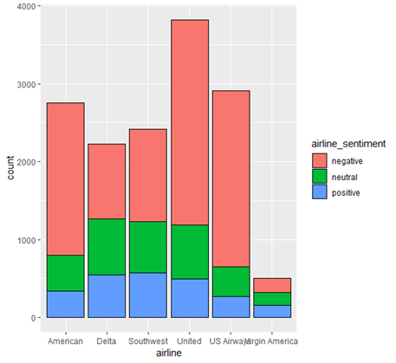
Sentiment Per Airline

Slide 5
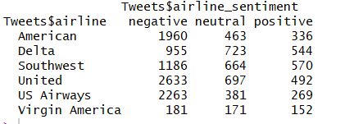
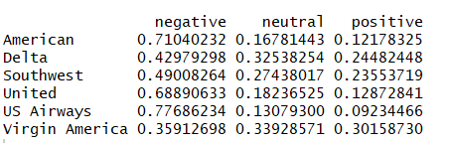
Sentiment per Airline
United had the most negative sentiment tweets
US Airways had the highest percentage of negative tweets
Southwest had the most positive sentiment tweets
Virgin America had the highest percentage of positive tweets

Slide 6
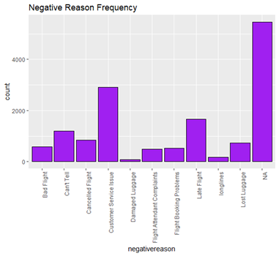

Negative Reasons
Most issues could not be determined by the algorithm
Otherwise, customer service issues were the highest, followed by late flights

Slide 7
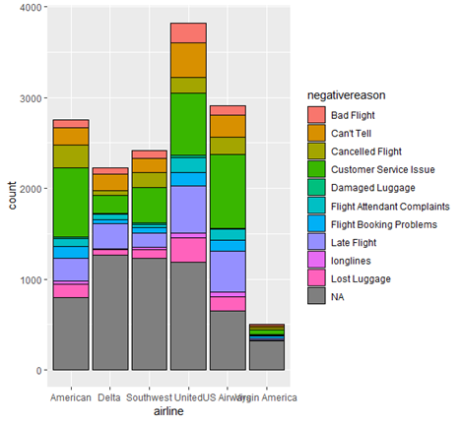
Negative Reason per airline
Most reported issue was US Airways and Customer Service Issues
United Airways had the most late flights

Slide 8

Most Frequent Users
Users most likely to give feedback and be responsive to the issues they decided to take to Twitter for

Slide 9
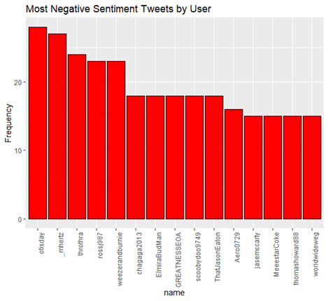
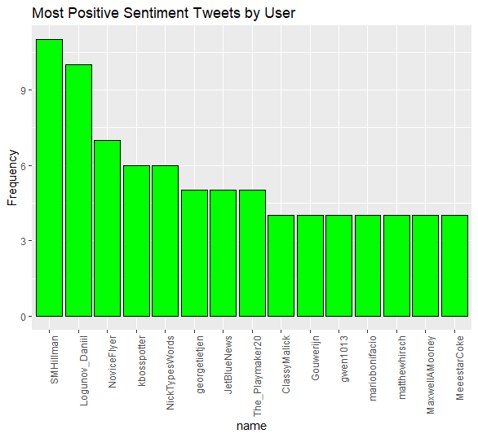
Biggest Fans & Haters

Slide 10
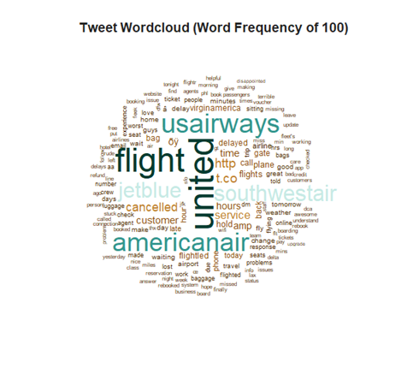
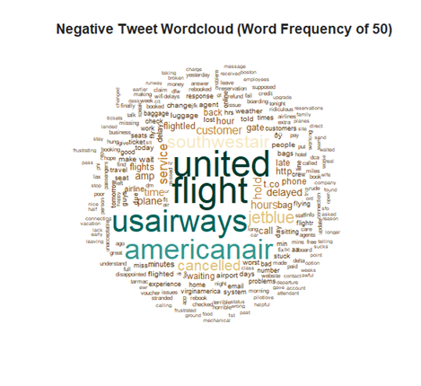
Wordclouds

Slide 11
Appendix
Many variables were unusable or not useful
Many records left blank
Retweet count
“Gold” columns
“Bad” data for many of the variables
Location
Timezone
Not a lot of potential for predictive modeling
Figured this out after way too many hors
Interesting to learn/infer about the model used to classify text

